Slide 1
CSE 417T Introduction to Machine Learning
Instructor: Chien-Ju (CJ) Ho

Slide 2
Logistics
Join Piazza
https://piazza.com/wustl/fall2022/cse417t
You are responsible for following the announcements on Piazza
Homework
Homework 0 is a warm-up for you to see whether you are comfortable with the course content/requirements
Homework 1 will be announced next week
The questions in HW0 will appear in HW1 as well
Probability cheatsheet
http://www.wzchen.com/probability-cheatsheet

Slide 3
Logistics: Grading and Exams
Homework assignments (5 to 6): 50%
Mix of programming and pencil-and-paper problems
Worst score discounted by 50%
Programming language: Python
We don’t teach how to program Python
5 total late days, no more than 2 on any one assignment
Two exams: 50% (25% each)
One in the middle of the semester (sometime in mid-to-late October)
One on the last lecture of the semester
Each exam covers around half of the materials. No separate final exam.
More details will be announced later

Slide 4
Logistics: Academic Integrity
Discussion (conceptually) about course content and homework assignments is encouraged.
How to make sure to not violate academic integrity?
Rule of thumb:
You must write down the answers/codes entirely on your own.
Can’t look at the write-up / codes by others.
Ask if you are not sure.

Slide 5
Recap

Slide 6
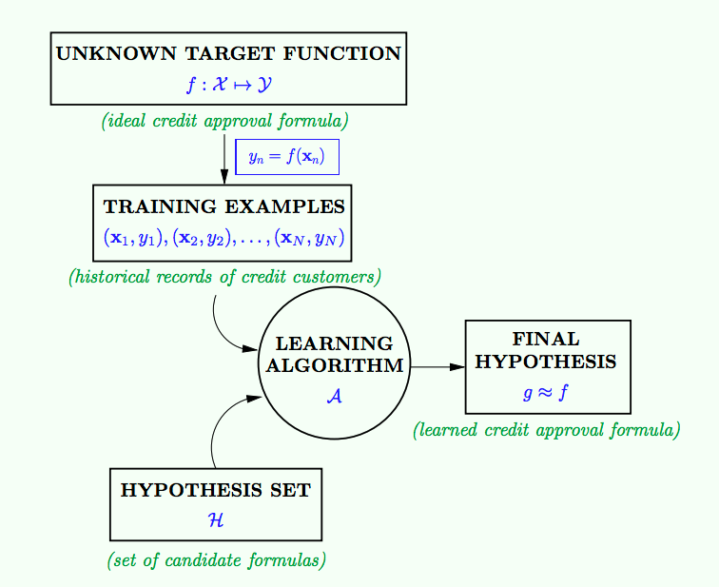
Given by the learning problem
Goal of learning
learning model

Slide 7

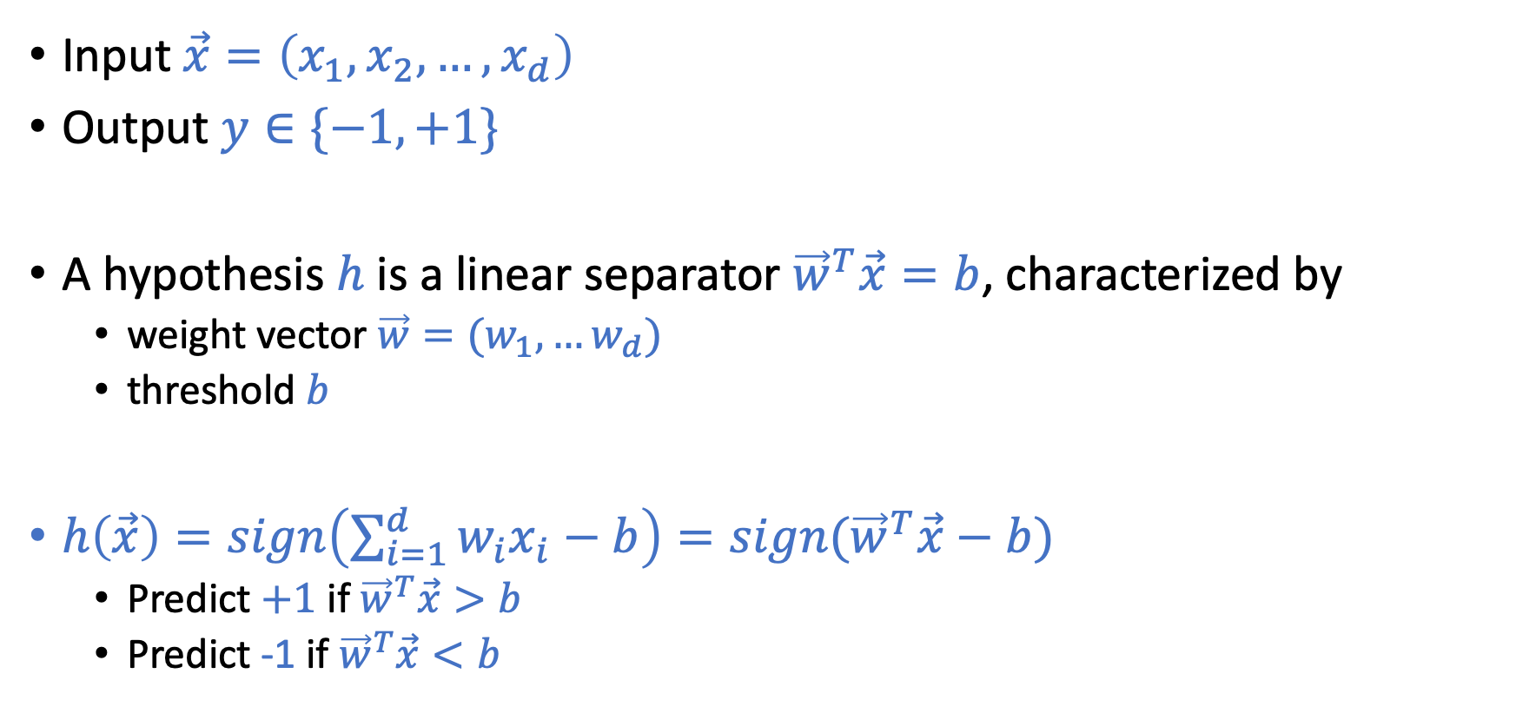
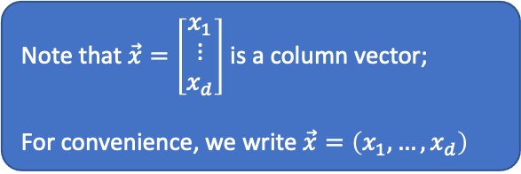
Linear Hypothesis Space (Perceptron)
Note that $\vec{x}=\left[\begin{matrix}x_{1} \\ ⋮ \\ x_{d}\end{matrix}\right]$ is a column vector;
For convenience, we write $\vec{x}=\left(x_{1},…,x_{d}\right)$
Input $\vec{x}=\left(x_{1},x_{2},…,x_{d}\right)$
Output $y∈\{−1,+1\}$
A hypothesis $h$ is a linear separator ${\vec{w}}^{T}\vec{x}=b$, characterized by
weight vector $\vec{w}=(w_{1},…w_{d})$
threshold $b$
$h\left(\vec{x}\right)=sign\left(\sum_{i=1}^{d}{w_{i}x_{i}}−b\right)=sign({\vec{w}}^{T}\vec{x}−b)$
Predict $+1$ if ${\vec{w}}^{T}\vec{x}>b$
Predict -1 if ${\vec{w}}^{T}\vec{x}<b$

Slide 8
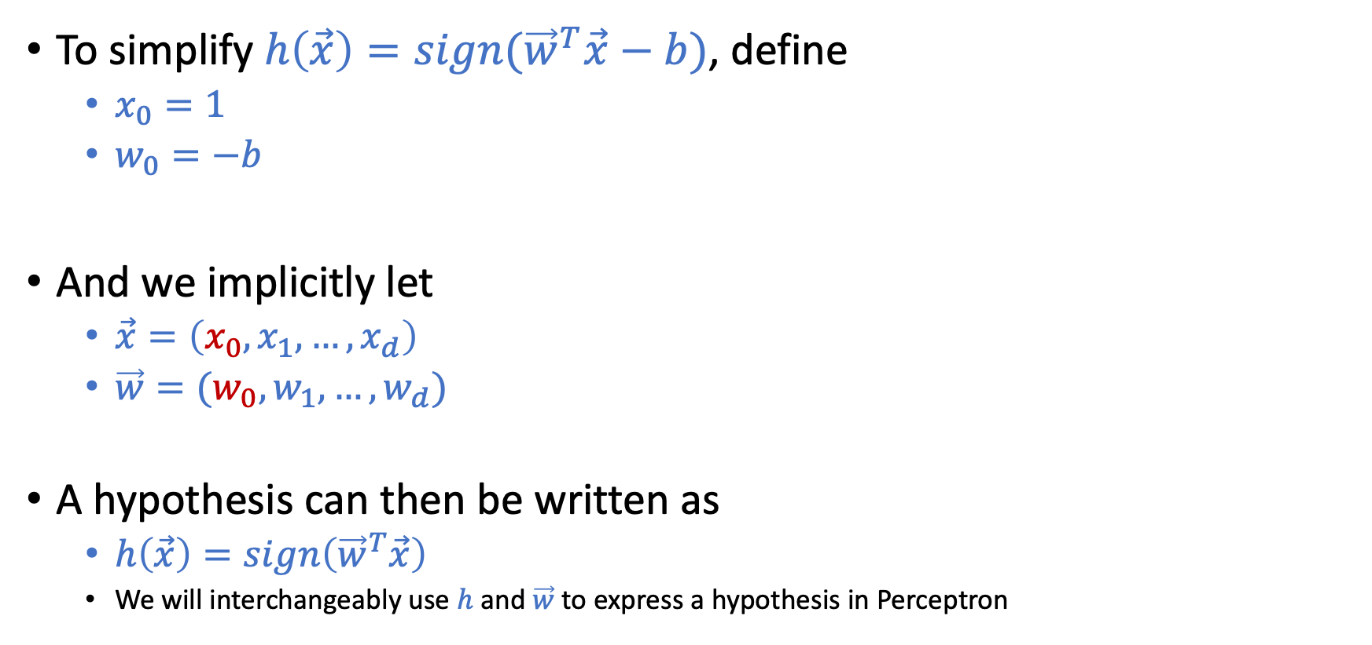
Linear Hypothesis Space (Perceptron)
To simplify $h\left(\vec{x}\right)=sign({\vec{w}}^{T}\vec{x}−b)$, define
$x_{0}=1$
$w_{0}=−b$
And we implicitly let
$\vec{x}=\left(x_{0},x_{1},…,x_{d}\right)$
$\vec{w}=(w_{0},w_{1},…,w_{d})$
A hypothesis can then be written as
$h\left(\vec{x}\right)=sign\left({\vec{w}}^{T}\vec{x}\right)$
We will interchangeably use $h$ and $\vec{w}$ to express a hypothesis in Perceptron

Slide 9
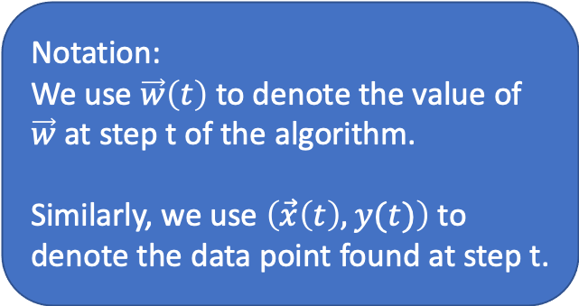
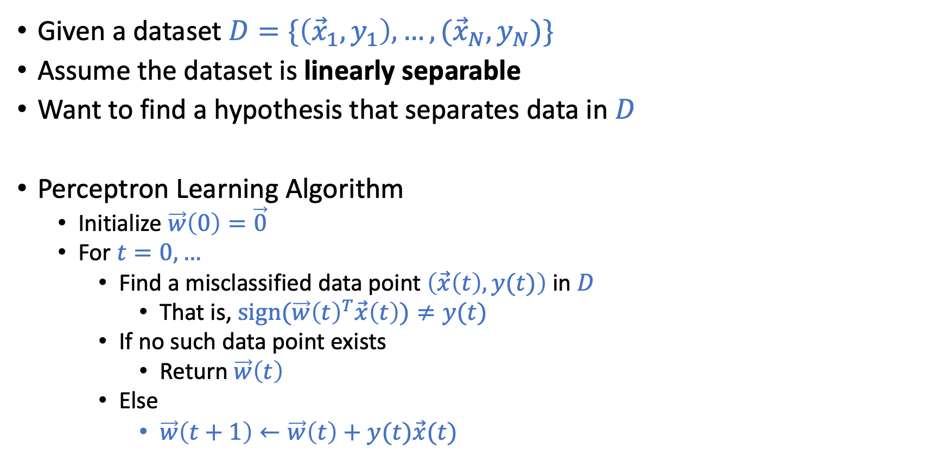
Perceptron Learning Algorithm (PLA)
Given a dataset $D=\{\left({\vec{x}}_{1},y_{1}\right),…,({\vec{x}}_{N},y_{N})\}$
Assume the dataset is linearly separable
Want to find a hypothesis that separates data in $D$
Perceptron Learning Algorithm
Initialize $\vec{w}\left(0\right)=\vec{0}$
For $t=0,…$
Find a misclassified data point $\left(\vec{x}\left(t\right),y(t)\right)$ in $D$
That is, $sign(\vec{w}{\left(t\right)}^{T}\vec{x}\left(t\right))≠y(t)$
If no such data point exists
Return $\vec{w}\left(t\right)$
Else
$\vec{w}\left(t+1\right)←\vec{w}\left(t\right)+y(t)\vec{x}(t)$
Notation:
We use $\vec{w}\left(t\right)$ to denote the value of $\vec{w}$ at step t of the algorithm. Similarly, we use $\left(\vec{x}\left(t\right),y(t)\right)$ to denote the data point found at step t.

Slide 10
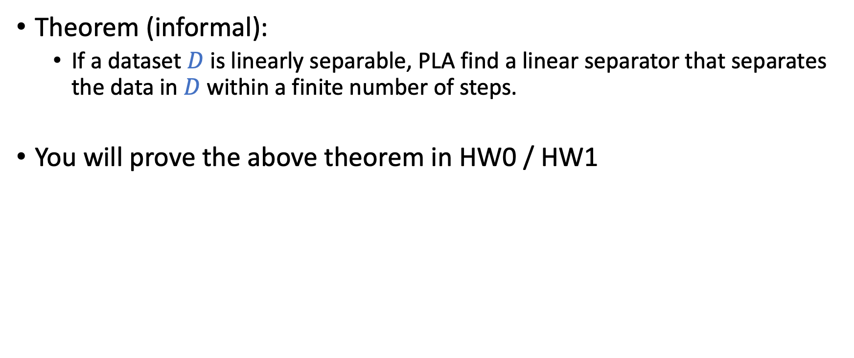
Perceptron Learning Algorithm (PLA)
Theorem (informal):
If a dataset $D$ is linearly separable, PLA find a linear separator that separates the data in $D$ within a finite number of steps.
You will prove the above theorem in HW0 / HW1

Slide 11
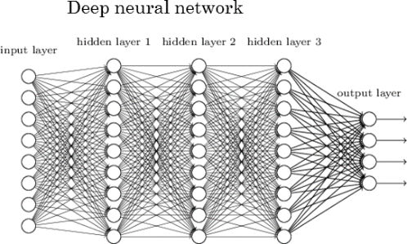
Perceptron
Graphical Representation
Deep learning (neural network with many layers)
Inspired by neurons:
The output signal is triggered when the weighted combination of the inputs is larger than some threshold

Slide 12
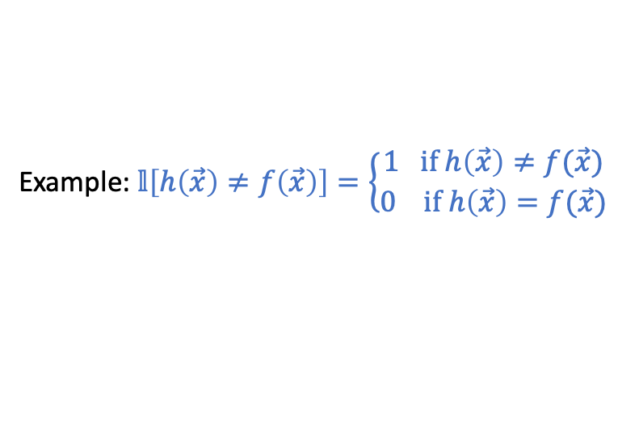
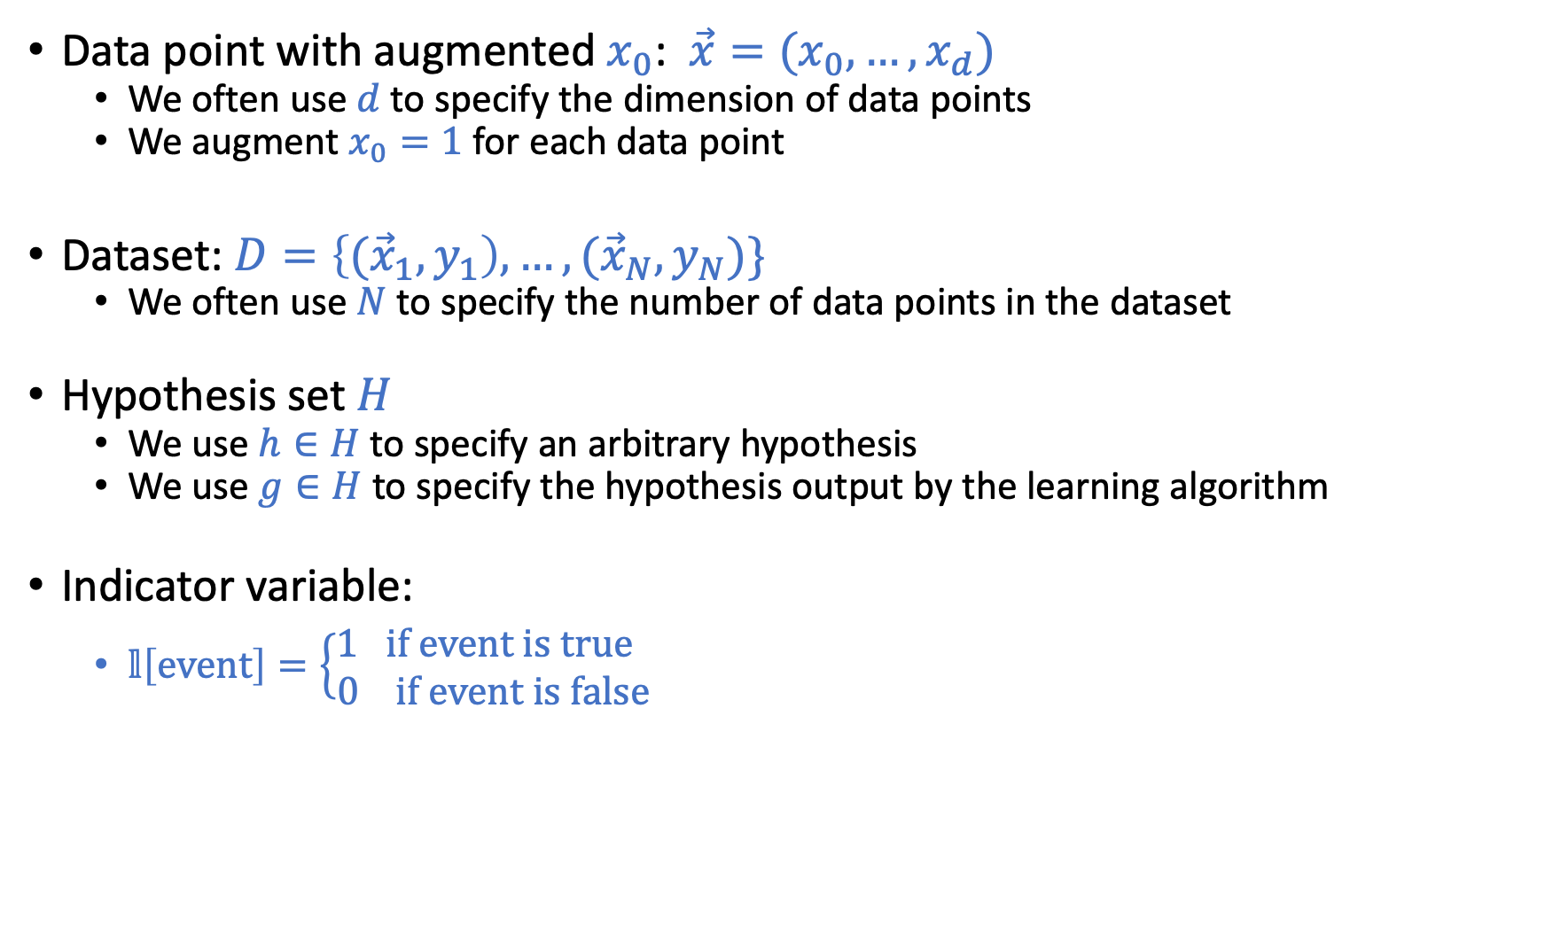
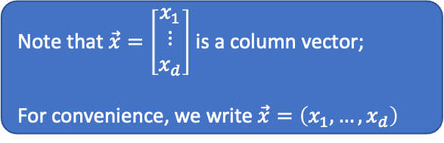
Common Notations in This Course
Data point with augmented $x_{0}$: $\vec{x}=(x_{0},…,x_{d})$
We often use $d$ to specify the dimension of data points
We augment $x_{0}=1$ for each data point
Dataset: $D=\left\{{(\vec{x}}_{1},y_{1}\right),…,({\vec{x}}_{N},y_{N})\}$
We often use $N$ to specify the number of data points in the dataset
Hypothesis set $H$
We use $h∈H$ to specify an arbitrary hypothesis
We use $g∈H$ to specify the hypothesis output by the learning algorithm
Indicator variable:
$𝕝\left[event\right]=\left\{\begin{matrix}1 if event is true \\ 0 if event is false\end{matrix} \right.$
Note that $\vec{x}=\left[\begin{matrix}x_{1} \\ ⋮ \\ x_{d}\end{matrix}\right]$ is a column vector;
For convenience, we write $\vec{x}=\left(x_{1},…,x_{d}\right)$
Example: $𝕝\left[h\left(\vec{x}\right)≠f\left(\vec{x}\right)\right]=\left\{\begin{matrix}1 if h\left(\vec{x}\right)≠f(\vec{x}) \\ 0 if h\left(\vec{x}\right)=f(\vec{x})\end{matrix} \right.$

Slide 13
Lecture Today
The notes are not intended to be comprehensive.
Let me know if you spot errors.

Slide 14
Given by the learning problem
learning model
(example: H: Perceptron
A: PLA)
Goal of learning?

Slide 15
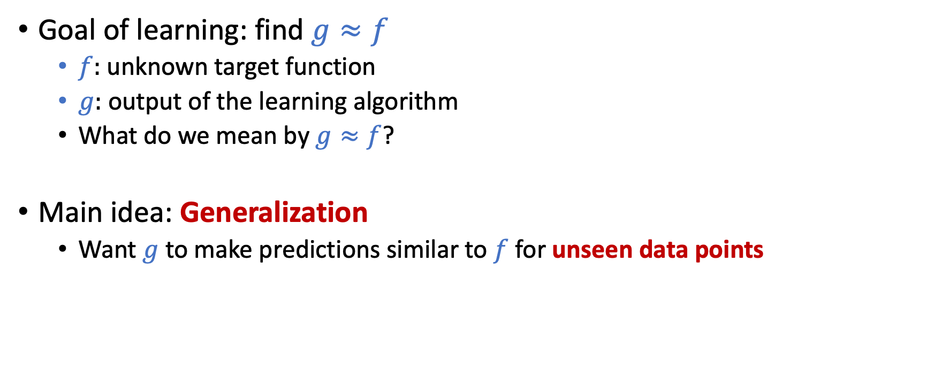
How Do We Formally Characterize the Goal?
Goal of learning: find $g≈f$
$f:$ unknown target function
$g:$ output of the learning algorithm
What do we mean by $g≈f$?
Main idea: Generalization
Want $g$ to make predictions similar to $f$ for unseen data points
Focus of today’s lecture:
Feasibility of learning
Can we achieve generalization?

Slide 16
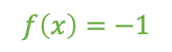
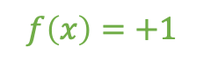
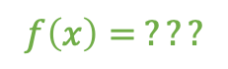
$$f\left(x\right)=+1$$
Training Dataset
$$f\left(x\right)=−1$$
Predict for unseen points
(Generalization)
$$f\left(x\right)= ???$$

Slide 17
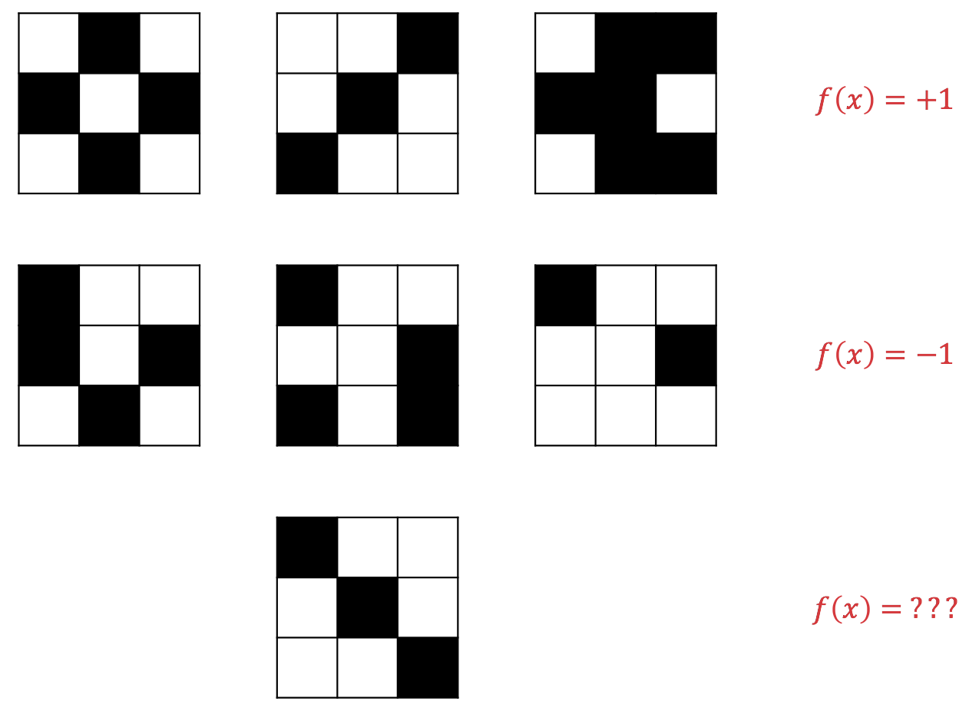
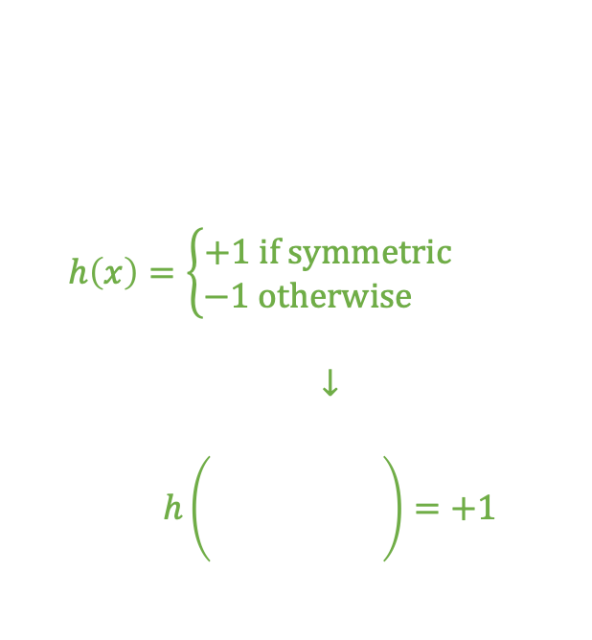
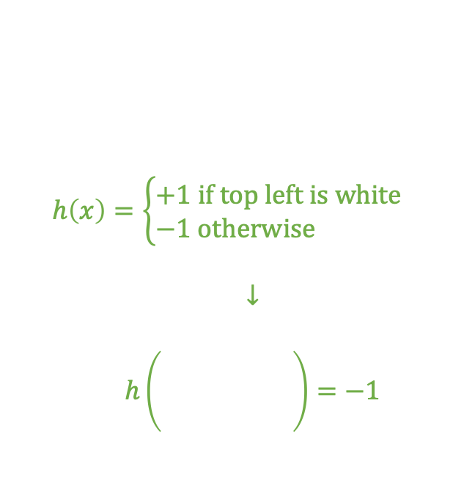
$$h\left(x\right)=\left\{\begin{aligned}+1 if symmetric \\ &−1 otherwise \end{aligned}\right.$$
$$↓$$
$$h\left(\begin{matrix} & & \\ & & \\ & & \end{matrix}\right)=+1$$
Hypothesis 1
$$h\left(x\right)=\left\{\begin{aligned}+1 if top left is white \\ &−1 otherwise \end{aligned}\right.$$
$$↓$$
$$h\left(\begin{matrix} & & \\ & & \\ & & \end{matrix}\right)=−1$$
Hypothesis 2
You can come up with many more hypothesis

Slide 18



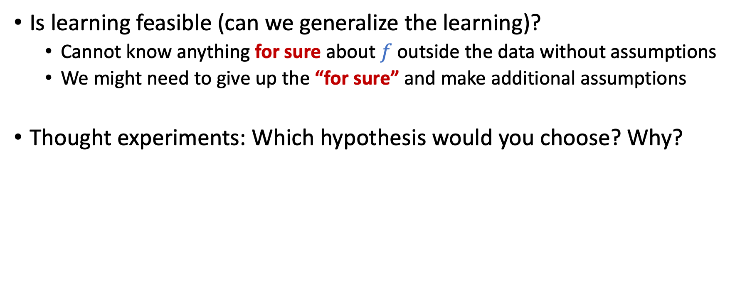


Feasibility of Learning
Is learning feasible (can we generalize the learning)?
Cannot know anything for sure about $f$ outside the data without assumptions
We might need to give up the “for sure” and make additional assumptions
Thought experiments: Which hypothesis would you choose? Why?

Slide 19
Key assumption of ML
Training data points and test data points are i.i.d. drawn from the same (unknown) distribution
Remarks
Modern ML is built on probabilistic inference with this assumption
The assumption is a reasonable approximation in many useful scenarios
The assumption might not hold in other cases
There are various research efforts on this, but it’s outside of the scope of this course

Slide 22
Let’s discuss probability first
We’ll then talk about how it connects back to machine learning

Slide 23
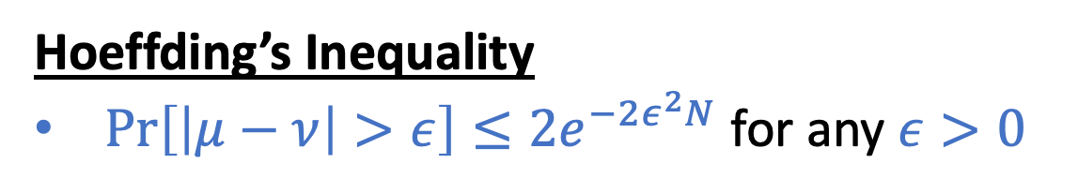
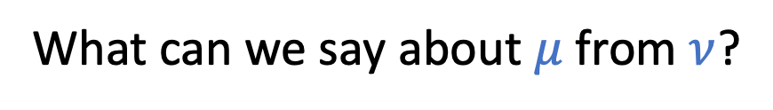
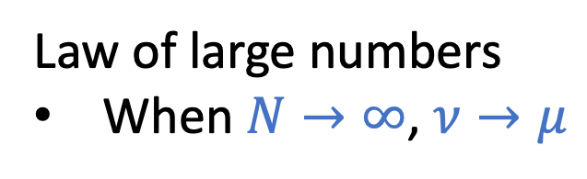
A Thought Experiment about Probability
What can we say about $μ$ from $ν$?
Draw with replacement
Law of large numbers
When $N→∞$, $ν→μ$
Hoeffding’s Inequality
$\operatorname{Pr}\left[\left|μ−ν\right|>ε\right]≤2e^{−2ε^{2}N}$ for any $ε>0$
N: number of samples

Slide 24
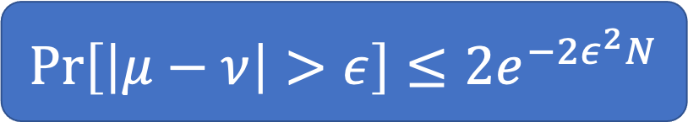
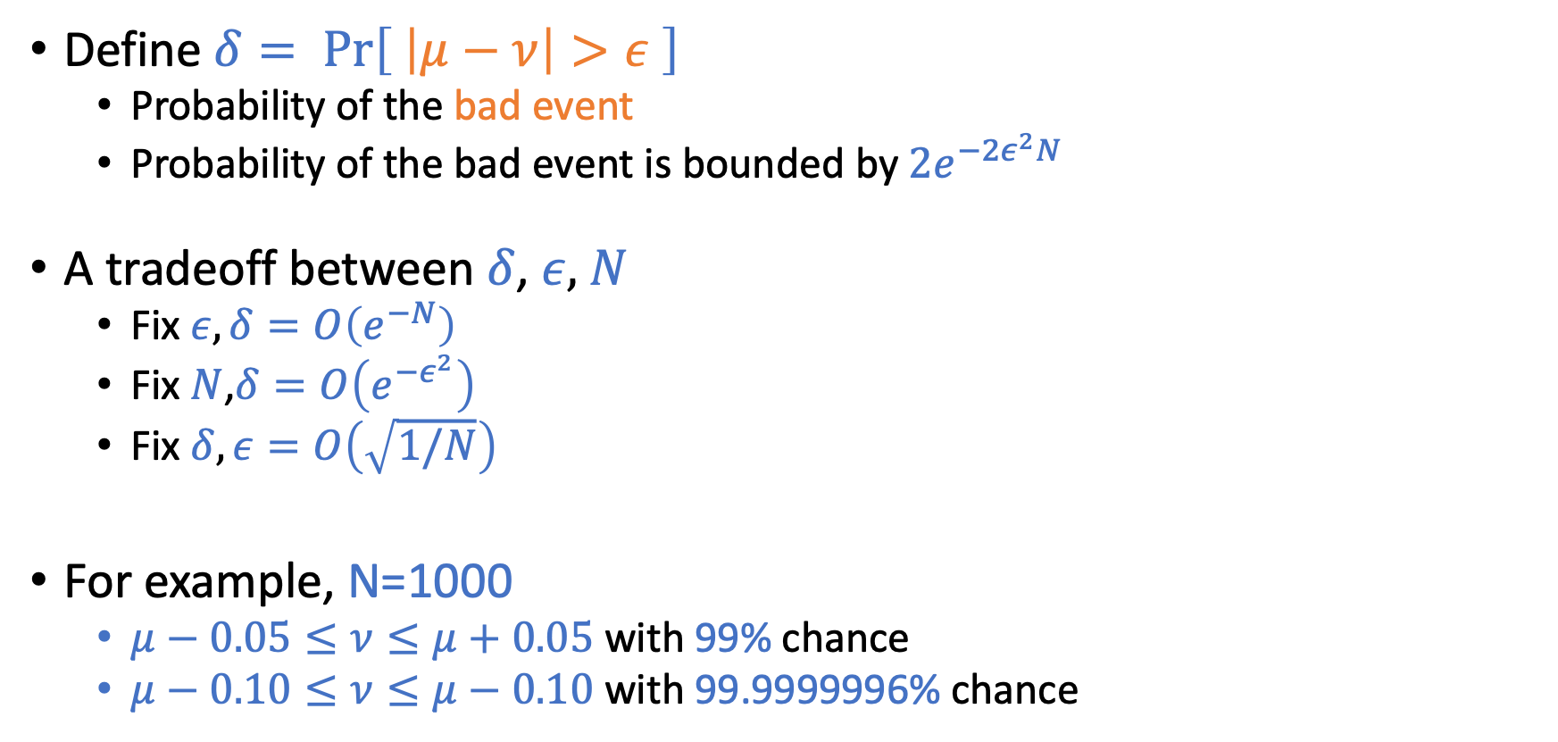
Interpretations
$$\operatorname{Pr}\left[\left|μ−ν\right|>ε\right]≤2e^{−2ε^{2}N}$$
Define $δ= \operatorname{Pr}\left[ \left|μ−ν\right|>ε \right]$
Probability of the bad event
Probability of the bad event is bounded by $2e^{−2ε^{2}N}$
A tradeoff between $δ$, $ε,$ $N$
Fix $ε, δ=O\left(e^{−N}\right)$
Fix $N$,$δ=O\left(e^{−ε^{2}}\right)$
Fix $δ, ε=O\left(\sqrt{1/N}\right)$
For example, N=1000
$μ−0.05≤ν≤μ+0.05$ with 99% chance
$μ−0.10≤ν≤μ−0.10$ with 99.9999996% chance
Draw with replacement
N: number of samples

Slide 25
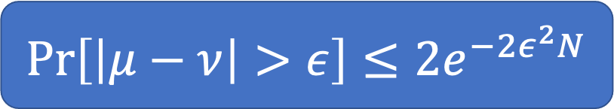
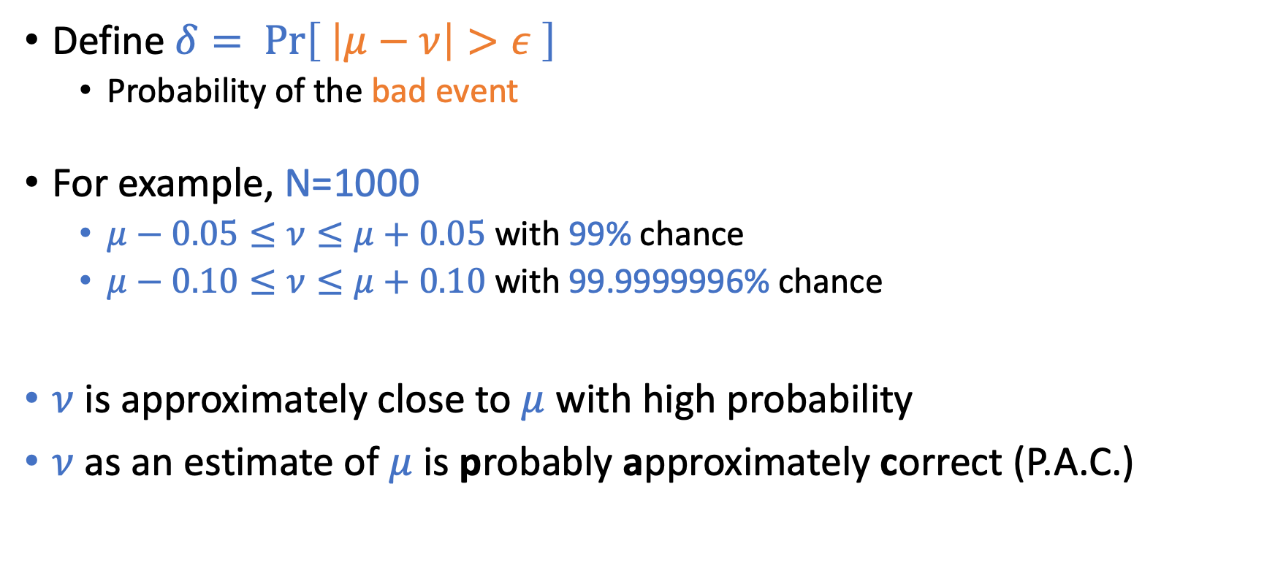
Interpretations
$$\operatorname{Pr}\left[\left|μ−ν\right|>ε\right]≤2e^{−2ε^{2}N}$$
Define $δ= \operatorname{Pr}\left[ \left|μ−ν\right|>ε \right]$
Probability of the bad event
For example, N=1000
$μ−0.05≤ν≤μ+0.05$ with 99% chance
$μ−0.10≤ν≤μ+0.10$ with 99.9999996% chance
$ν$ is approximately close to $μ$ with high probability
$ν$ as an estimate of $μ$ is probably approximately correct (P.A.C.)
Draw with replacement
N: number of samples
PAC learning is proposed by Leslie Valiant, who wins the Turing award in 2010.

Slide 26
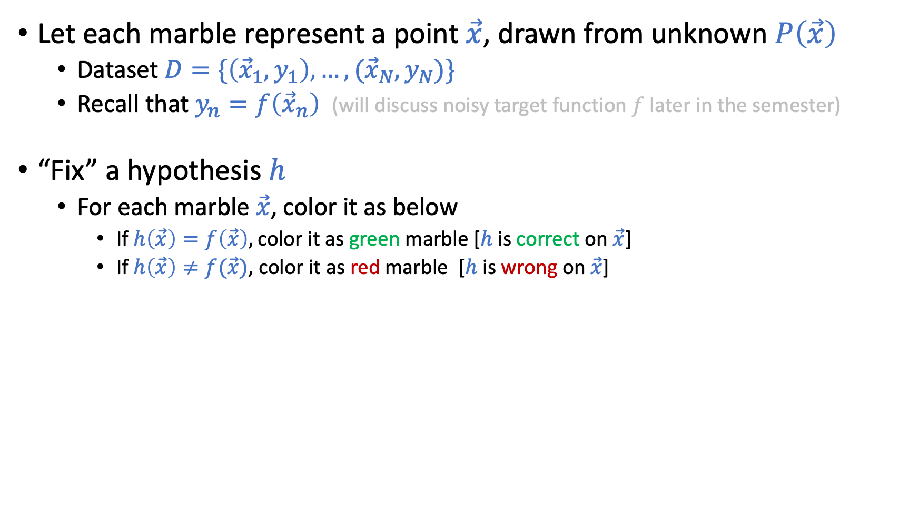
Connection to Learning
Let each marble represent a point $\vec{x}$, drawn from unknown $P\left(\vec{x}\right)$
Dataset $D=\{\left({\vec{x}}_{1},y_{1}\right),…,({\vec{x}}_{N},y_{N})\}$
Recall that $y_{n}=f\left({\vec{x}}_{n}\right)$ (will discuss noisy target function $f$ later in the semester)
“Fix” a hypothesis $h$
For each marble $\vec{x}$, color it as below
If $h\left(\vec{x}\right)=f\left(\vec{x}\right),$color it as green marble [$h$ is correct on $\vec{x}$]
If $h\left(\vec{x}\right)≠f(\vec{x})$, color it as red marble [$h$ is wrong on $\vec{x}$]
Draw with replacement
N: number of samples

Slide 27


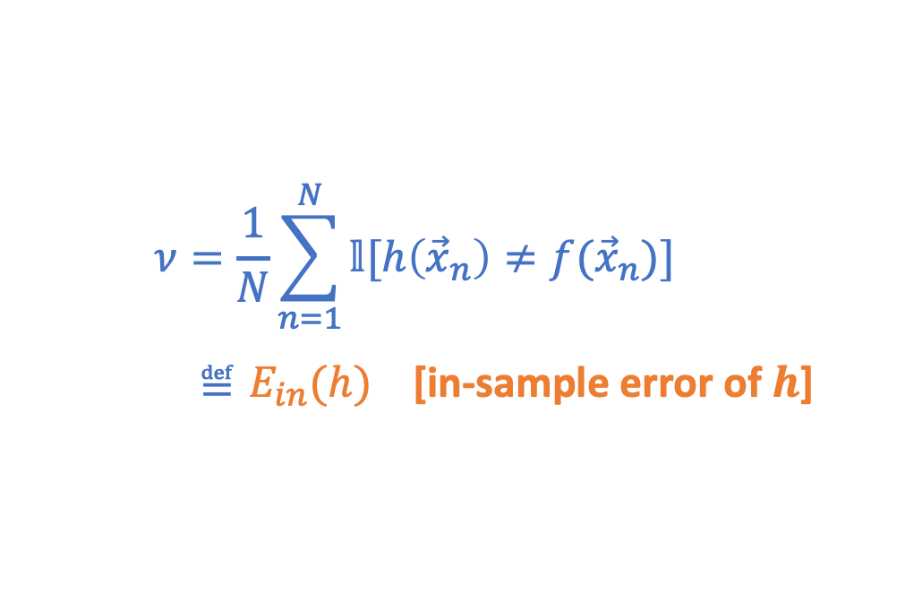
Connection to Learning
Let each marble represent a point $\vec{x}$, drawn from unknown $P\left(\vec{x}\right)$
Dataset $D=\{\left({\vec{x}}_{1},y_{1}\right),…,({\vec{x}}_{N},y_{N})\}$
Recall that $y_{n}=f\left({\vec{x}}_{n}\right)$ (will discuss noisy target function $f$ later in the semester)
“Fix” a hypothesis $h$
For each marble $\vec{x}$, color it as below
If $h\left(\vec{x}\right)=f\left(\vec{x}\right),$color it as green marble [$h$ is correct on $\vec{x}$]
If $h\left(\vec{x}\right)≠f(\vec{x})$, color it as red marble [$h$ is wrong on $\vec{x}$]
With the above coloring
Draw with replacement
N: number of samples
$$ν=\frac{1}{N}\sum_{n=1}^{N}{𝕝[h\left({\vec{x}}_{n}\right)≠f({\vec{x}}_{n})]}$$
$≝E_{in}(h)$ [in-sample error of $h\text{]}$
$$μ=\underset{\vec{x}\sim P(\vec{x})}{Pr}{[h\left(\vec{x}\right)≠f(\vec{x})]}$$ $≝E_{out}(h)$ [Out-of-sample error of $h]$

Slide 28
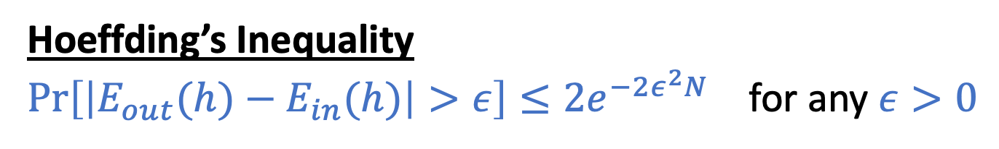
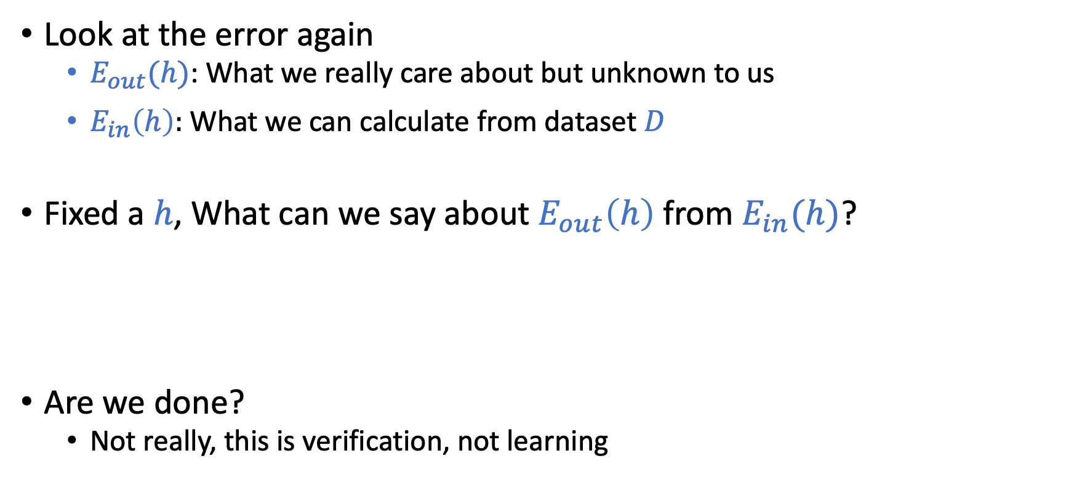

Connection to Learning
$$\operatorname{Pr}\left[\left|μ−ν\right|>ε\right]≤2e^{−2ε^{2}N}$$
Draw with replacement
Look at the error again
$E_{out}(h)$: What we really care about but unknown to us
$E_{in}\left(h\right):$ What we can calculate from dataset $D$
Fixed a $h$, What can we say about $E_{out}\left(h\right)$ from $E_{in}(h)$?
Are we done?
Not really, this is verification, not learning
N: number of samples
Hoeffding’s Inequality
$\operatorname{Pr}\left[\left|E_{out}(h)−E_{in}(h)\right|>ε\right]≤2e^{−2ε^{2}N}$ for any $ε>0$

Slide 29
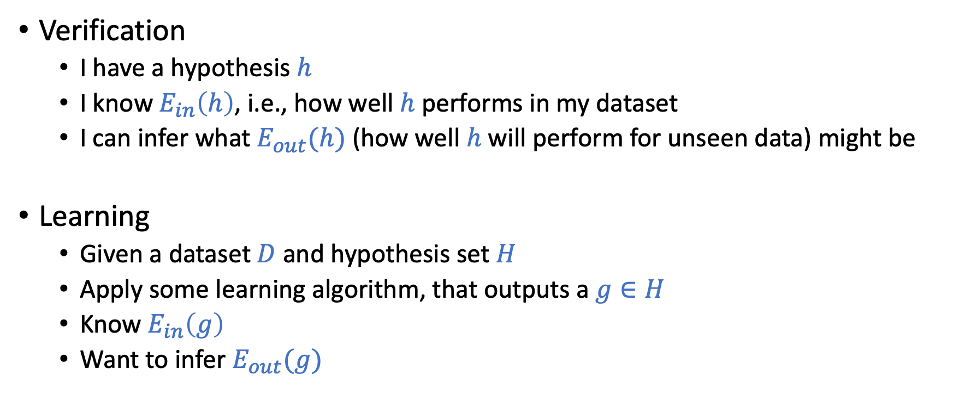
Verification vs. Learning
Verification
I have a hypothesis $h$
I know $E_{in}\left(h\right)$, i.e., how well $h$ performs in my dataset
I can infer what $E_{out}(h)$ (how well $h$ will perform for unseen data) might be
Learning
Given a dataset $D$and hypothesis set $H$
Apply some learning algorithm, that outputs a $g∈H$
Know $E_{in}\left(g\right)$
Want to infer $E_{out}(g)$

Slide 30
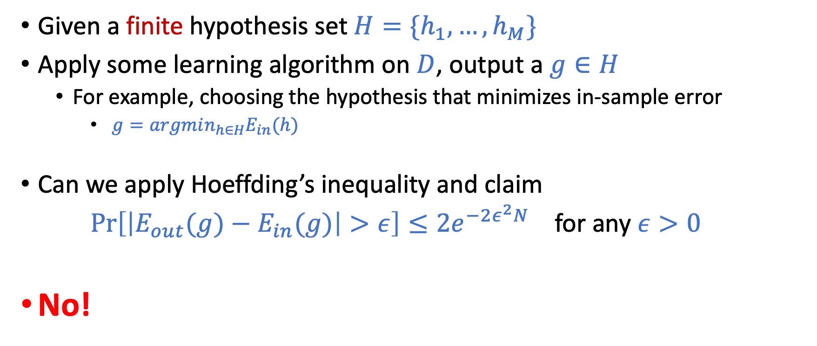
Connection to “Real” Learning
Given a finite hypothesis set $H=\{h_{1},…,h_{M}\}$
Apply some learning algorithm on $D$, output a $g∈H$
For example, choosing the hypothesis that minimizes in-sample error
$g=argmin_{h∈H}E_{in}(h)$
Can we apply Hoeffding’s inequality and claim $\operatorname{Pr}\left[\left|E_{out}(g)−E_{in}(g)\right|>ε\right]≤2e^{−2ε^{2}N}$ for any $ε>0$
No!

Slide 31
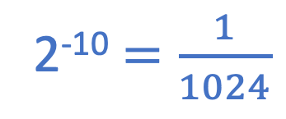
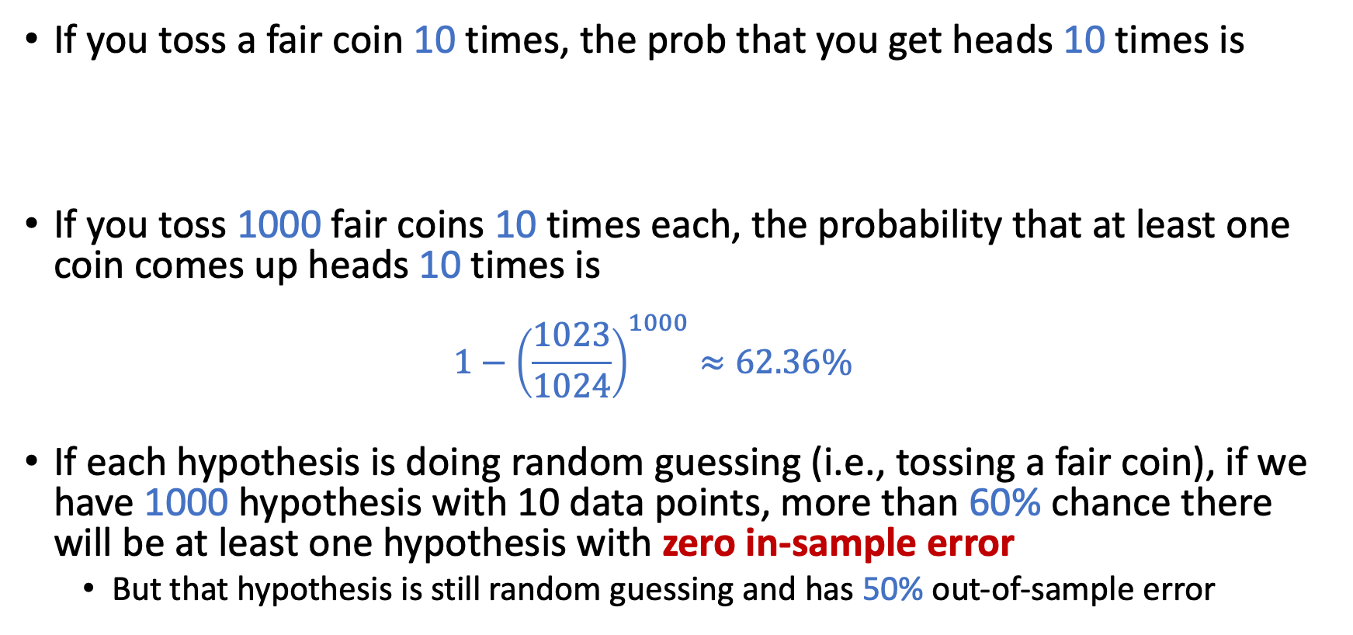
Consider this example
If you toss a fair coin 10 times, the prob that you get heads 10 times is
If you toss 1000 fair coins 10 times each, the probability that at least one coin comes up heads 10 times is
$$1−{\left(\frac{1023}{1024}\right)}^{1000}≈62.36\%$$
If each hypothesis is doing random guessing (i.e., tossing a fair coin), if we have 1000 hypothesis with 10 data points, more than 60% chance there will be at least one hypothesis with zero in-sample error
But that hypothesis is still random guessing and has 50% out-of-sample error
2⁻¹⁰ $=\frac{1}{1024}$

Slide 32
An Analogy
Three fair coins, numbered by 1, 2, 3.
Flip each coin 10 times
Question: (choosing from >5, =5, or <5)
For coin 1, what’s the expected number of heads among 10 flips?
Randomly choose a coin, what’s the expected number of heads for this coin?
Look at the realized flips and choose the coin with the largest number of heads. What is the expected number of heads (on the already flipped results) for the coin?
Without observing the flips, choose the coin anyway you like, what is the expected number of heads of the 10 flips for this coin?
You will simulate this process (with 1,000 coins) in HW1.
Ans: = 5
Ans: = 5
Ans: >5
Ans: = 5

Slide 33
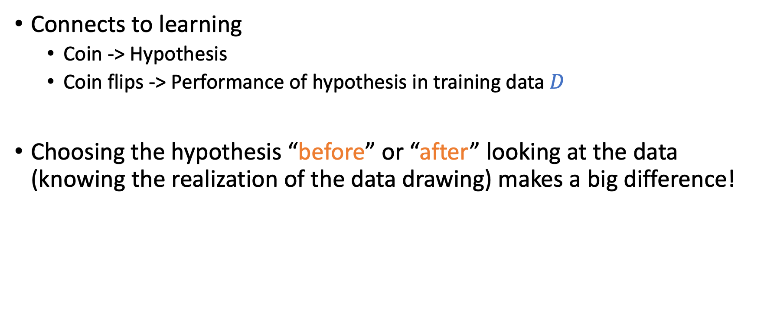
An Analogy
Connects to learning
Coin -> Hypothesis
Coin flips -> Performance of hypothesis in training data $D$
Choosing the hypothesis “before” or “after” looking at the data (knowing the realization of the data drawing) makes a big difference!

Slide 34
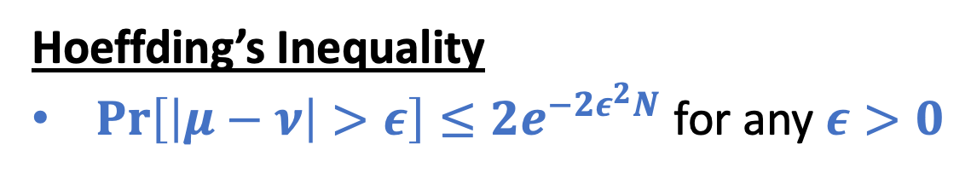
An Analogy
Hoeffding’s Inequality
$\operatorname{Pr}\left[\left|μ−ν\right|>ε\right]≤2e^{−2ε^{2}N}$ for any $ε>0$
Some graphical explanations
Notes:
Draw the PDF
Show that with more samples, the PDF “concentrates around mean”
Then argue that, if we sample multiple points from the same PDF, we are likely to get lucky

Slide 35
From xkcd, by Randall Munroe: http://xkcd.com/882

Slide 36

From xkcd, by Randall Munroe: http://xkcd.com/882

Slide 37
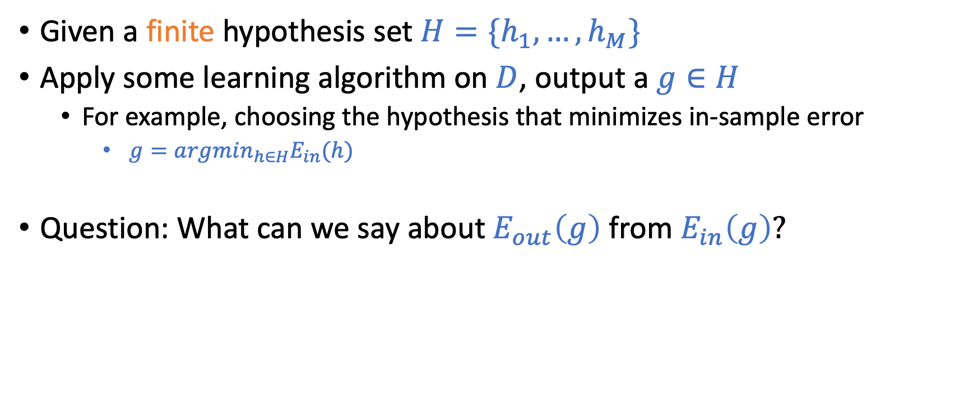
Connection to “Real” Learning
Given a finite hypothesis set $H=\{h_{1},…,h_{M}\}$
Apply some learning algorithm on $D$, output a $g∈H$
For example, choosing the hypothesis that minimizes in-sample error
$g=argmin_{h∈H}E_{in}(h)$
Question: What can we say about $E_{out}\left(g\right)$ from $E_{in}\left(g\right)?$

Slide 38
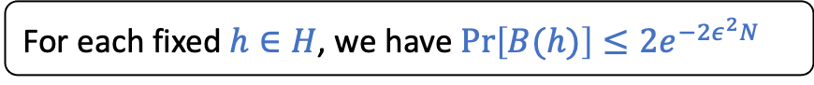
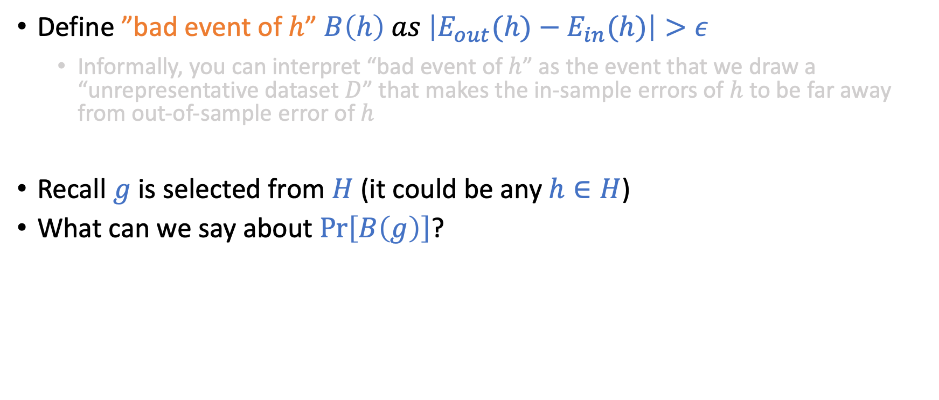
Derivations
Define ”bad event of $h$” $B\left(h\right) as \left|E_{out}(h)−E_{in}(h)\right|>ε$
Informally, you can interpret “bad event of $h$” as the event that we draw a “unrepresentative dataset $D$” that makes the in-sample errors of $h$ to be far away from out-of-sample error of $h$
Recall $g$ is selected from $H$ (it could be any $h∈H$)
What can we say about $\operatorname{Pr}\left[B\left(g\right)\right]$?
$$\operatorname{Pr}\left[B\left(g\right)\right]≤\operatorname{Pr}\left[B\left(h_{1}\right) or B\left(h_{2}\right) or …or B\left(h_{M}\right)\right]$$
$≤\operatorname{Pr}\left[B\left(h_{1}\right)\right]+$ $\operatorname{Pr}\left[B\left(h_{2}\right)\right]+…+Pr⁡[B(h_{M})]$
$≤M 2e^{−2ε^{2}N}$
For each fixed $h∈H$, we have $\operatorname{Pr}\left[B(h)\right]≤2e^{−2ε^{2}N}$

Slide 39
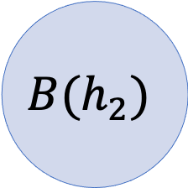
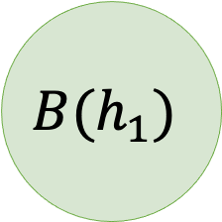
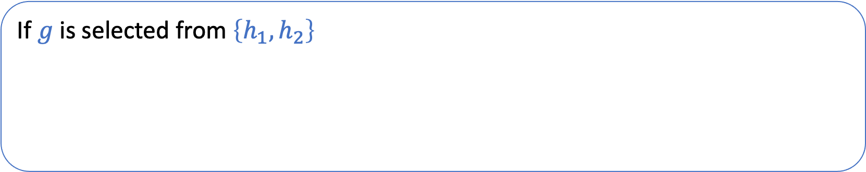
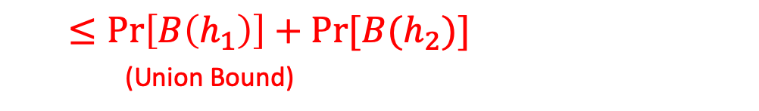
Derivations
Define ”bad event of $h$” $B\left(h\right) as \left|E_{out}(h)−E_{in}(h)\right|>ε$
Informally, you can interpret “bad event of $h$” as the event that we draw a “unrepresentative dataset $D$” that makes the in-sample errors of $h$ to be far away from out-of-sample error of $h$
Recall $g$ is selected from $H$ (it could be any $h∈H$)
What can we say about $\operatorname{Pr}\left[B\left(g\right)\right]$?
$$\operatorname{Pr}\left[B\left(g\right)\right]≤\operatorname{Pr}\left[B\left(h_{1}\right) or B\left(h_{2}\right) or …or B\left(h_{M}\right)\right]$$
$≤\operatorname{Pr}\left[B\left(h_{1}\right)\right]+$ $\operatorname{Pr}\left[B\left(h_{2}\right)\right]+…+Pr⁡[B(h_{M})]$
$≤M 2e^{−2ε^{2}N}$
For each fixed $h∈H$, we have $\operatorname{Pr}\left[B(h)\right]≤2e^{−2ε^{2}N}$
If $g$ is selected from $\left\{h_{1},h_{2}\right\}$
$$B\left(g\right)⊆B\left(h_{1}\right)∪B\left(h_{2}\right)$$
$$B(h_{1})$$
$$B(h_{2})$$
$$\operatorname{Pr}\left[B\left(g\right)\right]≤\operatorname{Pr}\left[B\left(h_{1}\right) \text{or} B\left(h_{2}\right)\right]$$
$≤\operatorname{Pr}\left[B\left(h_{1}\right)\right]+Pr⁡[B(h_{2})]$ (Union Bound)

Slide 40
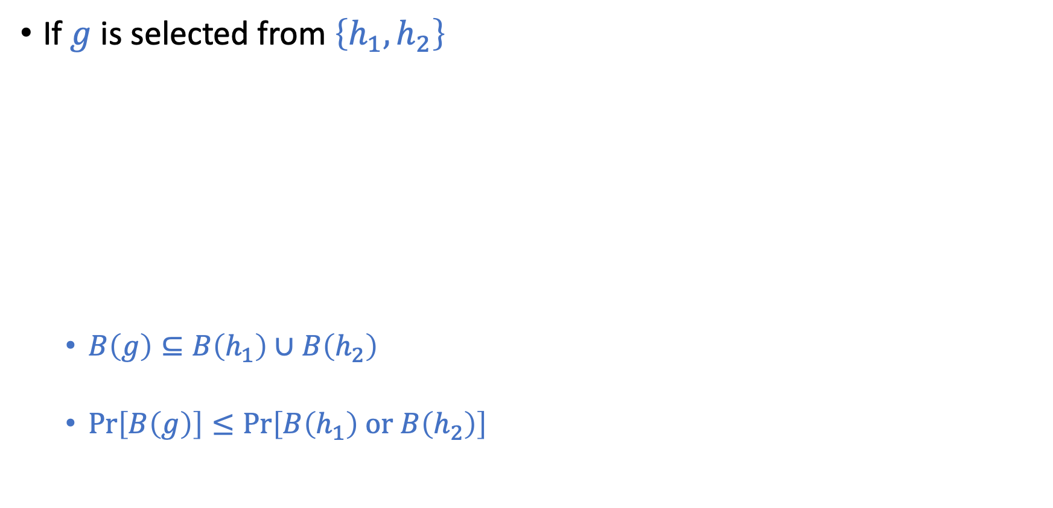


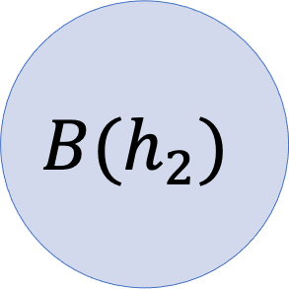
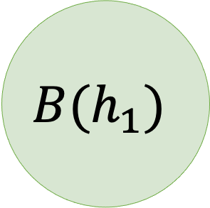
Bounding $\operatorname{Pr}\left[B\left(g\right)\right]$?
If $g$ is selected from $\left\{h_{1},h_{2}\right\}$
$B\left(g\right)⊆B\left(h_{1}\right)∪B\left(h_{2}\right)$
$\operatorname{Pr}\left[B\left(g\right)\right]≤\operatorname{Pr}\left[B\left(h_{1}\right) \text{or} B\left(h_{2}\right)\right]$
$$B(h_{1})$$
$$B(h_{2})$$
$≤\operatorname{Pr}\left[B\left(h_{1}\right)\right]+Pr⁡[B(h_{2})]$ (Union Bound)

Slide 41
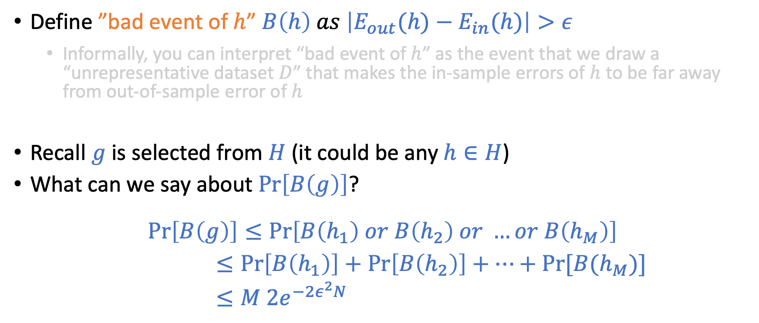
Derivations
Define ”bad event of $h$” $B\left(h\right) as \left|E_{out}(h)−E_{in}(h)\right|>ε$
Informally, you can interpret “bad event of $h$” as the event that we draw a “unrepresentative dataset $D$” that makes the in-sample errors of $h$ to be far away from out-of-sample error of $h$
Recall $g$ is selected from $H$ (it could be any $h∈H$)
What can we say about $\operatorname{Pr}\left[B\left(g\right)\right]$?
$$\operatorname{Pr}\left[B\left(g\right)\right]≤\operatorname{Pr}\left[B\left(h_{1}\right) or B\left(h_{2}\right) or …or B\left(h_{M}\right)\right]$$
$≤\operatorname{Pr}\left[B\left(h_{1}\right)\right]+$ $\operatorname{Pr}\left[B\left(h_{2}\right)\right]+…+Pr⁡[B(h_{M})]$
$≤M 2e^{−2ε^{2}N}$
For each fixed $h∈H$, we have $\operatorname{Pr}\left[B(h)\right]≤2e^{−2ε^{2}N}$

Slide 42
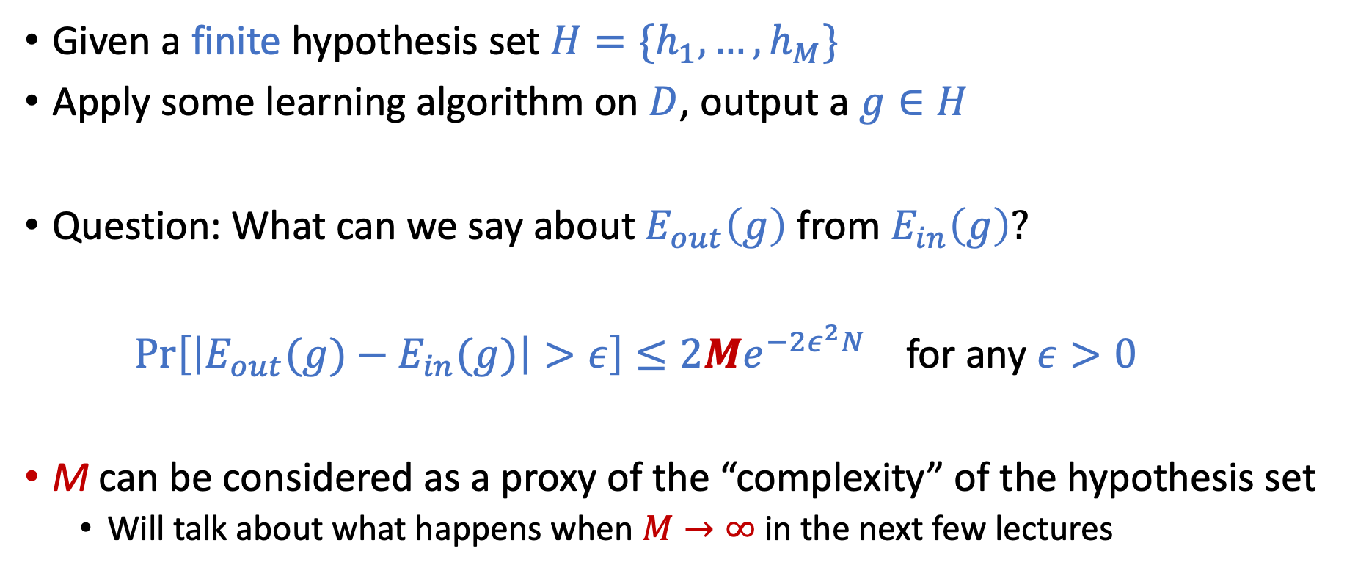
Connection to “Real” Learning
Given a finite hypothesis set $H=\{h_{1},…,h_{M}\}$
Apply some learning algorithm on $D$, output a $g∈H$
Question: What can we say about $E_{out}\left(g\right)$ from $E_{in}\left(g\right)?$
$\operatorname{Pr}\left[\left|E_{out}(g)−E_{in}(g)\right|>ε\right]≤2Me^{−2ε^{2}N}$ for any $ε>0$
M can be considered as a proxy of the “complexity” of the hypothesis set
Will talk about what happens when $M→∞$ in the next few lectures

Slide 43
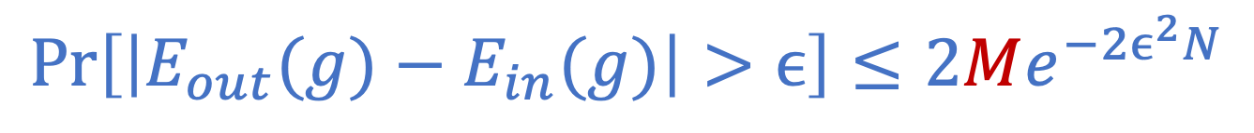
Interpreting
$$\operatorname{Pr}\left[\left|E_{out}(g)−E_{in}(g)\right|>ϵ\right]≤2Me^{−2ϵ^{2}N}$$

Slide 44
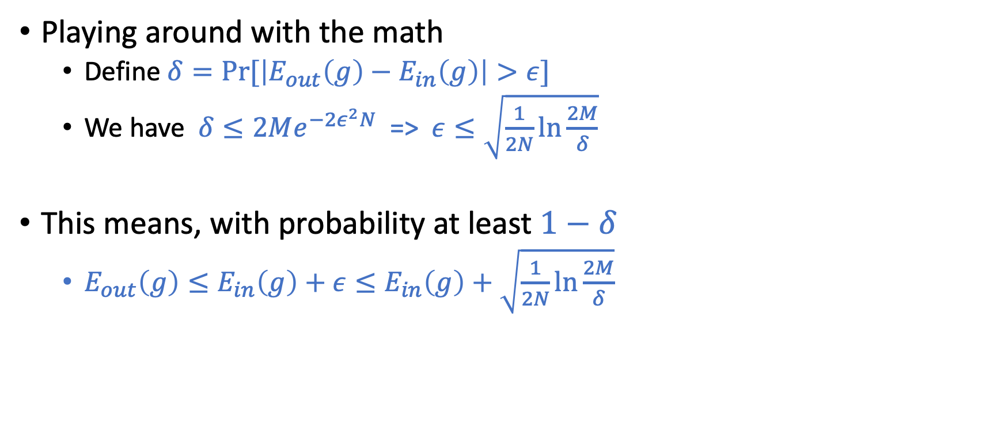
Interpreting
$$\operatorname{Pr}\left[\left|E_{out}(g)−E_{in}(g)\right|>ϵ\right]≤2Me^{−2ϵ^{2}N}$$
Playing around with the math
Define $δ=Pr⁡[\left|E_{out}\left(g\right)−E_{in}\left(g\right)\right|>ε]$
We have $δ≤2Me^{−2ε^{2}N}$ => $ε≤\sqrt{\frac{1}{2N}\ln{\frac{2M}{δ}}}$
This means, with probability at least $1−δ$
$E_{out}\left(g\right)≤E_{in}\left(g\right)+ε≤E_{in}\left(g\right)+$ $\sqrt{\frac{1}{2N}\ln{\frac{2M}{δ}}}$

Slide 45

More Discussion
With probability at least $1−δ$ $E_{out}\left(g\right)≤E_{in}\left(g\right)+$ $\sqrt{\frac{1}{2N}\ln{\frac{2M}{δ}}}$ Consider $M$ as a proxy measure on the “complexity” of $H$
Our ultimate goal is to have a small $E_{out}\left(g\right)$
There is a tradeoff of choosing $M$ (what “learning model” to use)
Increase $M$ -> Smaller $E_{in}\left(g\right)$ (more hypothesis to “fit” the training data)
Increase $M$ -> Larger $ε$
It also depends on $N,$ the number of data points you have
A small number of data points => use simple models (e.g., linear models)
Complex models (e.g., deep learning) work when you have a lot of data

Slide 46

Connection to “Real” Learning
Given a finite hypothesis set $H=\{h_{1},…,h_{M}\}$
Apply some learning algorithm on $D$, output a $g∈H$
Question: What can we say about $E_{out}\left(g\right)$ from $E_{in}\left(g\right)?$

Slide 47
Derivations
Define ”bad event of $h$” $B\left(h\right) as \left|E_{out}(h)−E_{in}(h)\right|>ε$
Informally, you can interpret “bad event of $h$” as the event that we draw a “unrepresentative dataset $D$” that makes the in-sample errors of $h$ to be far away from out-of-sample error of $h$
Recall $g$ is selected from $H$ (it could be any $h∈H$)
What can we say about $\operatorname{Pr}\left[B\left(g\right)\right]$?
$$\operatorname{Pr}\left[B\left(g\right)\right]≤\operatorname{Pr}\left[B\left(h_{1}\right) or B\left(h_{2}\right) or …or B\left(h_{M}\right)\right]$$
$≤\operatorname{Pr}\left[B\left(h_{1}\right)\right]+$ $\operatorname{Pr}\left[B\left(h_{2}\right)\right]+…+Pr⁡[B(h_{M})]$
$≤M 2e^{−2ε^{2}N}$
For each fixed $h∈H$, we have $\operatorname{Pr}\left[B(h)\right]≤2e^{−2ε^{2}N}$

Slide 48
Bounding $\operatorname{Pr}\left[B\left(g\right)\right]$?
If $g$ is selected from $\left\{h_{1},h_{2}\right\}$
$B\left(g\right)⊆B\left(h_{1}\right)∪B\left(h_{2}\right)$
$\operatorname{Pr}\left[B\left(g\right)\right]≤\operatorname{Pr}\left[B\left(h_{1}\right) \text{or} B\left(h_{2}\right)\right]$
$$B(h_{1})$$
$$B(h_{2})$$
$≤\operatorname{Pr}\left[B\left(h_{1}\right)\right]+Pr⁡[B(h_{2})]$ (Union Bound)

Slide 49
Derivations
Define ”bad event of $h$” $B\left(h\right) as \left|E_{out}(h)−E_{in}(h)\right|>ε$
Informally, you can interpret “bad event of $h$” as the event that we draw a “unrepresentative dataset $D$” that makes the in-sample errors of $h$ to be far away from out-of-sample error of $h$
Recall $g$ is selected from $H$ (it could be any $h∈H$)
What can we say about $\operatorname{Pr}\left[B\left(g\right)\right]$?
$$\operatorname{Pr}\left[B\left(g\right)\right]≤\operatorname{Pr}\left[B\left(h_{1}\right) or B\left(h_{2}\right) or …or B\left(h_{M}\right)\right]$$
$≤\operatorname{Pr}\left[B\left(h_{1}\right)\right]+$ $\operatorname{Pr}\left[B\left(h_{2}\right)\right]+…+Pr⁡[B(h_{M})]$
$≤M 2e^{−2ε^{2}N}$
For each fixed $h∈H$, we have $\operatorname{Pr}\left[B(h)\right]≤2e^{−2ε^{2}N}$

Slide 50

Connection to “Real” Learning
Given a finite hypothesis set $H=\{h_{1},…,h_{M}\}$
Apply some learning algorithm on $D$, output a $g∈H$
Question: What can we say about $E_{out}\left(g\right)$ from $E_{in}\left(g\right)?$
$\operatorname{Pr}\left[\left|E_{out}(g)−E_{in}(g)\right|>ε\right]≤2Me^{−2ε^{2}N}$ for any $ε>0$
M can be considered as a proxy of the “complexity” of the hypothesis set
Will talk about what happens when $M→∞$ in the next few lectures

Slide 51
Interpreting
$$\operatorname{Pr}\left[\left|E_{out}(g)−E_{in}(g)\right|>ϵ\right]≤2Me^{−2ϵ^{2}N}$$
Playing around with the math
Define $δ=Pr⁡[\left|E_{out}\left(g\right)−E_{in}\left(g\right)\right|>ε]$
We have $δ≤2Me^{−2ε^{2}N}$ => $ε≤\sqrt{\frac{1}{2N}\ln{\frac{2M}{δ}}}$
This means, with probability at least $1−δ$
$E_{out}\left(g\right)≤E_{in}\left(g\right)+ε≤E_{in}\left(g\right)+$ $\sqrt{\frac{1}{2N}\ln{\frac{2M}{δ}}}$

Slide 52
More Discussion
With probability at least $1−δ$ $E_{out}\left(g\right)≤E_{in}\left(g\right)+$ $\sqrt{\frac{1}{2N}\ln{\frac{2M}{δ}}}$ Consider $M$ as a proxy measure on the “complexity” of $H$
Our ultimate goal is to have a small $E_{out}\left(g\right)$
There is a tradeoff of choosing $M$ (what “learning model” to use)
Increase $M$ -> Smaller $E_{in}\left(g\right)$ (more hypothesis to “fit” the training data)
Increase $M$ -> Larger $ε$
It also depends on $N,$ the number of data points you have
A small number of data points => use simple models (e.g., linear models)
Complex models (e.g., deep learning) work when you have a lot of data

